Slide 1
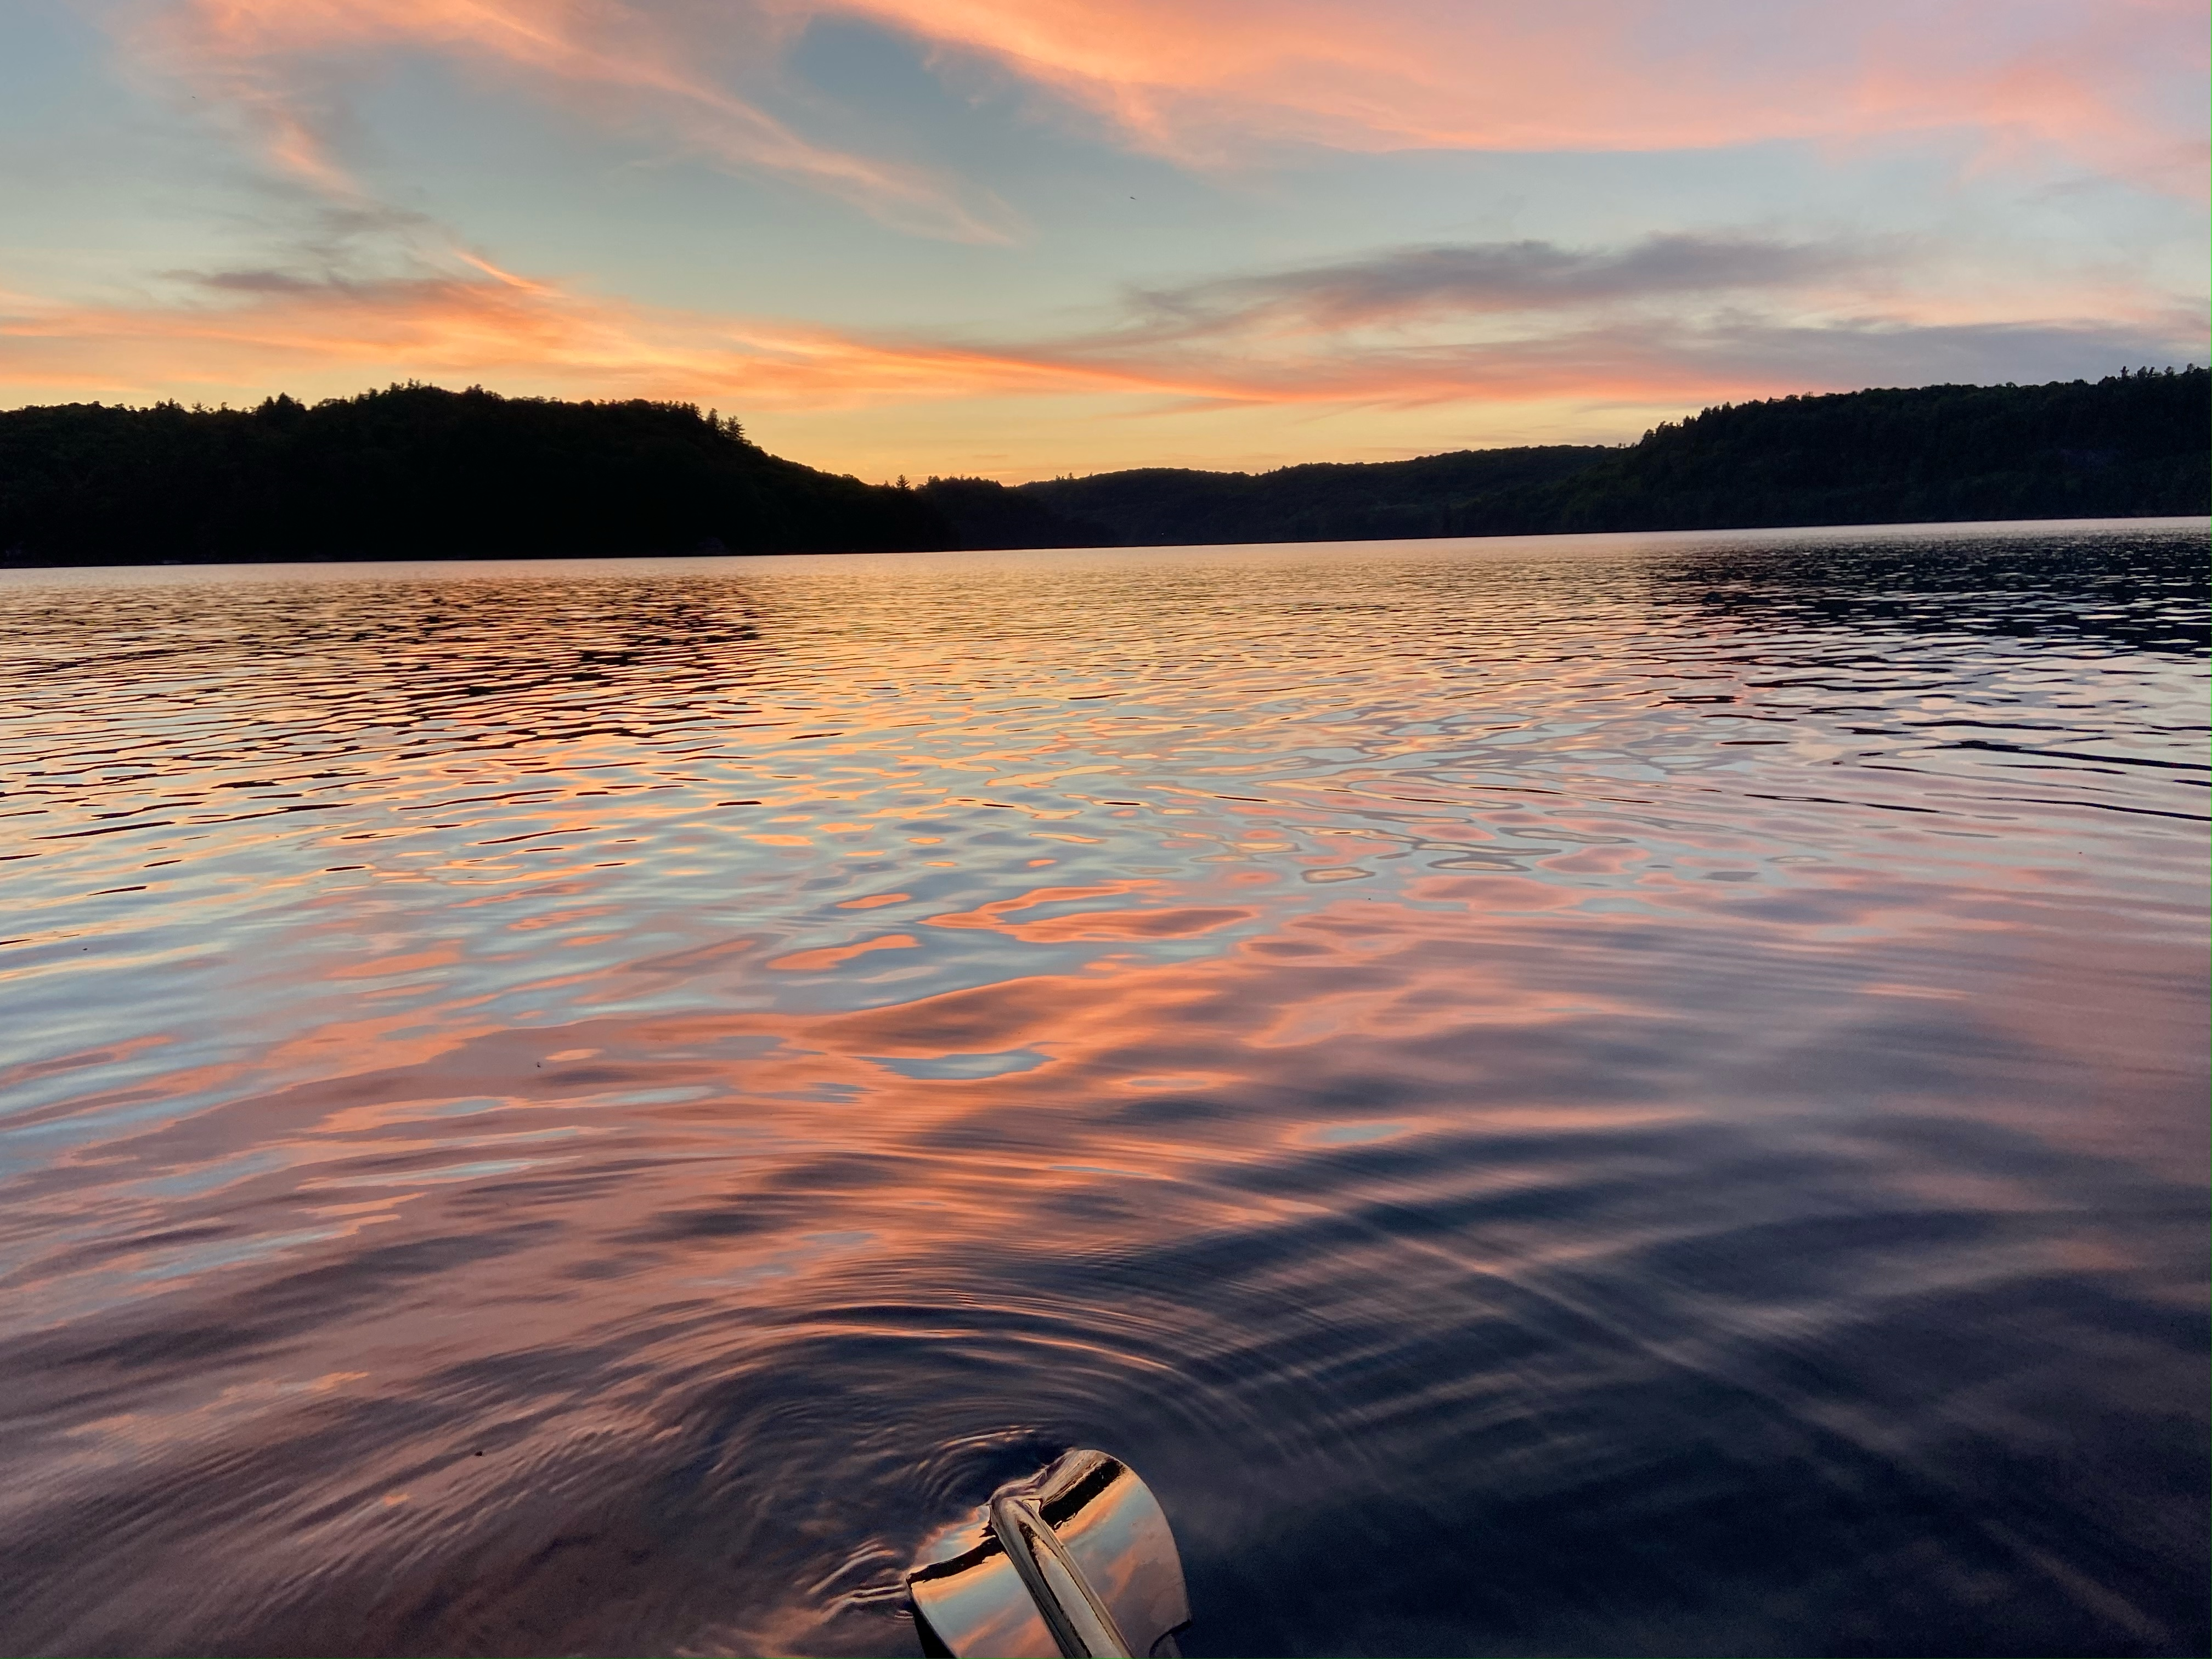
Redstone Lake Cottagers’ Association’s Lake Health Monitoring & Research
Jess Kidd, PhD
Lake Steward - Redstone Lake Cottagers Association
Aquatic Ecologist – Anglerfish Aquatic Science

Slide 2
Threats to Lake Health
Shoreline Development
Septic Systems
Boat Traffic
Landscaping
Climate Change
Acid Rain
Dams
Roads
Notes:
Previous stressors:
- Forestry and acid rain: calcium declines
Shoreline Development
Nutrient loading
Invasive species
Shoreline erosion
Geese
Faulty and Undersized Septic Systems
Nutrient loading
Bacteria contamination
Boat Traffic
Shoreline erosion
Habitat destruction
Invasive species
Roads
Salt
Climate change
Decreased oxygen
Algal blooms
Invasive species

Slide 3
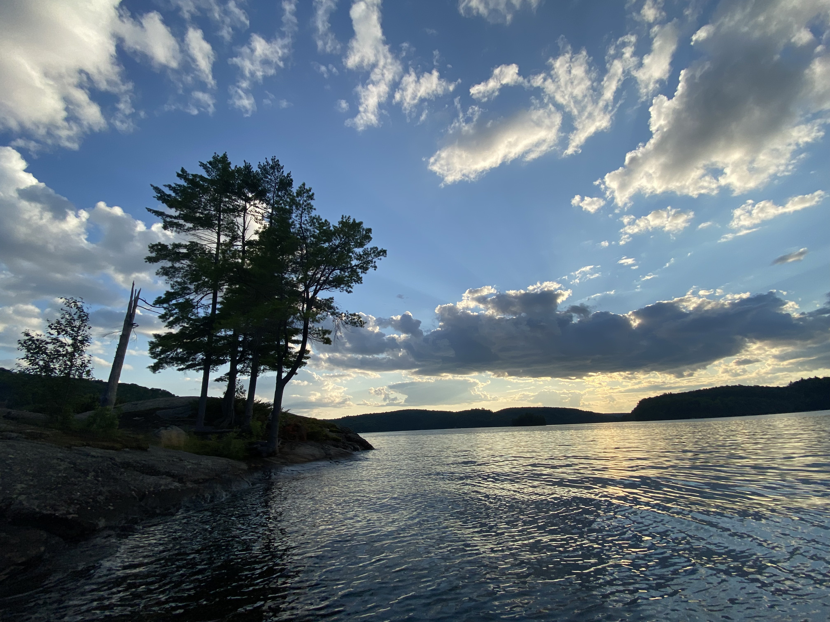
What do we know about the health of RLCA’s lakes?

Slide 4
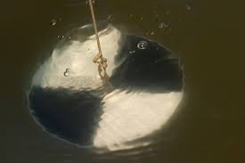
2025 Avg Secchi Disk Depth (m)
High transparency: > 4m
Big Red, Lil Red, Bitter, Burdock, Tedious
Moderate transparency: > 2m
Coleman, Pelaw
Notes:
Measure of how deep the sun can penetrate which controls where vegetation grows
Our lakes have moderate (>2) to high transparency (>4m)
2025 measurements are all within the normal range of what we would expect for each lake.;
Last year I was worried Pelaw’s transparency may be trending down, but it looks like it’s bounced back up to what we’d expect, important to continue to monitor

Slide 5
Spring Phosphorus Levels (ug/L)
All lakes below 20 ug/L threshold for algal blooms
Coleman >10 ug/L = Mesotrophic
Notes:
Important for algal growth
All lakes within range we would expect them to be.
Pelaw may be trending up, need to watch
Ontario Lakes
Good: <0.01 mg/L (10 ug/L) Oligotrophic (BC guidelines)
Moderate: 0.01-0.02 (10-20 ug/L) Mesotrophic
Poor: >0.02 (20 ug/L) Eutrophic
All of our lakes, except for Coleman, are below 10 ug/L so are oligotrophic. Coleman is mesotrophic (10-20 ug/L). Eutrophic is >20 ug/L
Used to interpret lake nutrient status
Phosphorous is the element that controls the growth of algae in most Ontario lakes
Increasing phosphorous may decrease water clarity by stimulating algal growth
Unproductive lakes that rarely experience algal blooms

Slide 6
Late Summer Phosphorus (ug/L)
All lakes considered “good” with values below 10 ug/L
Notes:
Measure of organic and inorganic forms of phosphorus. Can be present as dissolved or particulate matter. It is essential plant nutrient and often the most limiting nutrient to plant growth in freshwater. Concentrations in most lakes not affected by human activities is less than 0.01 mg/L. Inputs of phosphorus is the prime contributing factor to eutrophication in freshwater systems. (BC guidelines for interpreting water quality).
Ontario Lakes
Good: <0.01
Moderate: 0.01-0.02
Poor: >0.02
(BC guidelines for interpreting water quality).
Oligotrophic: <0.01 mg/L
Mesotrophic: 0.01-0.25 mg/L
Eutrophic: >0.025 mg/L
Total phosphorus (TP) is used as a primary indicator of excessive nutrient loading and may contribute to abundant aquatic vegetation growth and depleted dissolved oxygen levels. The Provincial Water Quality Objective (PWQO) is used as the TP Guideline and states that in streams concentrations greater than 0.030 mg/l indicate an excessive amount of TP. (https://watersheds.rvca.ca/subwatersheds-reports/middle-rideau/catchment-reports-middle-rideau/middle-rideau-black-creek/surface-water-quality-conditions)

Slide 7
Chloride Levels (mg/L)
Guideline for Aquatic Life: 120 mg/L
Toxic to water fleas: 10-20 mg/L
Bitter Lake stabilizing?
Burdock Lake: 40.6 mg/L
Notes:
Burdock. Chloride levels have been increasing since sampling began in 2017-2019 (26-33 mg/L). Now it is 41 mg/L for 2024 and 2025. We need to do an investigation and see where this chloride is coming from
Might be road salt from Hwy 7?
Salt water hot tub?
All concentrations below CCME water quality guideline for aquatic life: 120 mg/L
We’re seeing increases in Bitter – should check if anyone is using salted sand on Bitter Lake Rd or private laneway. Is there anyone from the Bitter Lake road association that could answer this?

Slide 8
Late Summer Chloride (mg/L)
Below Guideline for Aquatic Life: 120 mg/L
Notes:
Measure of organic and inorganic forms of phosphorus. Can be present as dissolved or particulate matter. It is essential plant nutrient and often the most limiting nutrient to plant growth in freshwater. Concentrations in most lakes not affected by human activities is less than 0.01 mg/L. Inputs of phosphorus is the prime contributing factor to eutrophication in freshwater systems. (BC guidelines for interpreting water quality).
Ontario Lakes
Good: <0.01
Moderate: 0.01-0.02
Poor: >0.02
(BC guidelines for interpreting water quality).
Oligotrophic: <0.01 mg/L
Mesotrophic: 0.01-0.25 mg/L
Eutrophic: >0.025 mg/L
Total phosphorus (TP) is used as a primary indicator of excessive nutrient loading and may contribute to abundant aquatic vegetation growth and depleted dissolved oxygen levels. The Provincial Water Quality Objective (PWQO) is used as the TP Guideline and states that in streams concentrations greater than 0.030 mg/l indicate an excessive amount of TP. (https://watersheds.rvca.ca/subwatersheds-reports/middle-rideau/catchment-reports-middle-rideau/middle-rideau-black-creek/surface-water-quality-conditions)

Slide 9
Calcium Levels (mg/L)
All lakes at or above 1.5 mg/L threshold for zooplankton
Low, <3 mg/L: Big Red, Lil Red, Pelaw
Mod, 3-20 mg/L: Coleman, Burdock, Bitter
Notes:
Coleman, Burdock, and Bitter MODERATE (3.1 – 20 mg/L)
Coleman and Bitter winning with 6.2 and 6.1, respectively
Burdock 3.7
Big and Little Red LOW (1.5-3.0 mg/L)
1.8 and 1.5, respectively
Acid rain depleted AND zooplankton
Calcium levels appear fairly stable, except Bitter was increasing and now may be stabilized.
Remaining lakes all have low (but above 1.5 mg/L threshold for zooplankton reproduction) calcium levels.
24% of lakes sampled by LPP are also low;
Low is typical of lakes on the shield due to the hard granite that takes longer to weather.
Nutrient required by all living organism
Zooplankton are very sensitive to declining calcium concentrations because they need it for their body coverings
Other aquatic organisms that need calcium: mollusks, clams, amphipods, crayfish
35% of Ontario lakes have calcium below 1.5 mg/L

Slide 10
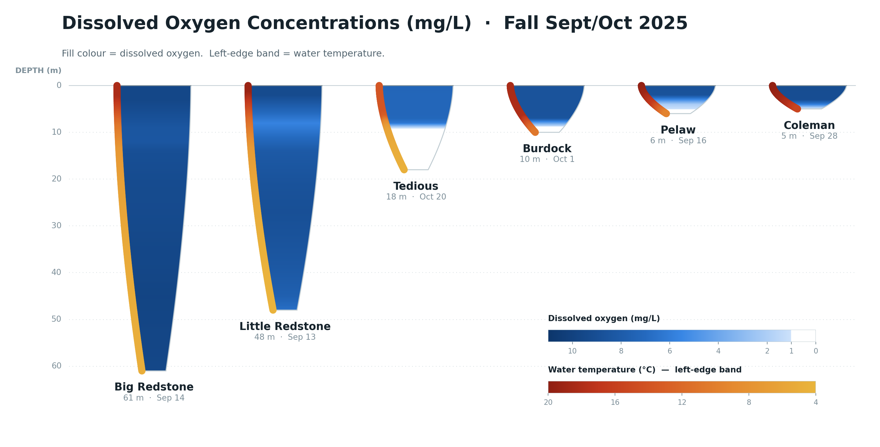
Notes:
Should we purchase a Van Dorn sampler to monitor deep water phosphorus concentrations in the late summer.
Low DO levels above the sediment surface can cause nutrients to be released from the sediment. Should continue to monitor to make sure oxygen isn’t going to 0.
Pelaw, Burdock, and Coleman were also anoxic at the bottom in 2024 and 2023. Option to collect nutrient samples near the bottom to see if nutrients are being released by the sediment.
2025 Bitter: Bitter Lake [August 25, 11:22 – 11:55]: 10.4 – 6.3 mg/L (bottom)

Slide 11
2025 Lake Stewards
Lewis McIntosh: Redstone
Peter Sergejewich: Little Redstone
Ken McMullen: Bitter Lake
Laurie Kerr: Burdock Lake
Chris Jones: Coleman Lake
Pelaw: Ed Payne
Tedious/Long: Frank Wunderlich

Slide 12
2025 Vegetation Surveys
August 2025: U-Links Centre for Community-Based Research carried out aquatic plant surveys on all seven RLCA lakes.
RLCA volunteers:
  Paula Miller and Milt Fullen (Little Redstone)
  Ed Payne (Pelaw)
  Jeff Hockley, Mark Johnson (Redstone)
  Gerry Oxford (Coleman)
  Frank Wunderlich (Long/Tedious)
  Laurie & Greg Kerr (Bitter & Burdock)
The surveys documented healthy native plant communities with relatively few concerns across all seven lakes.
A total of 34 to 42 species were found per lake

Slide 13
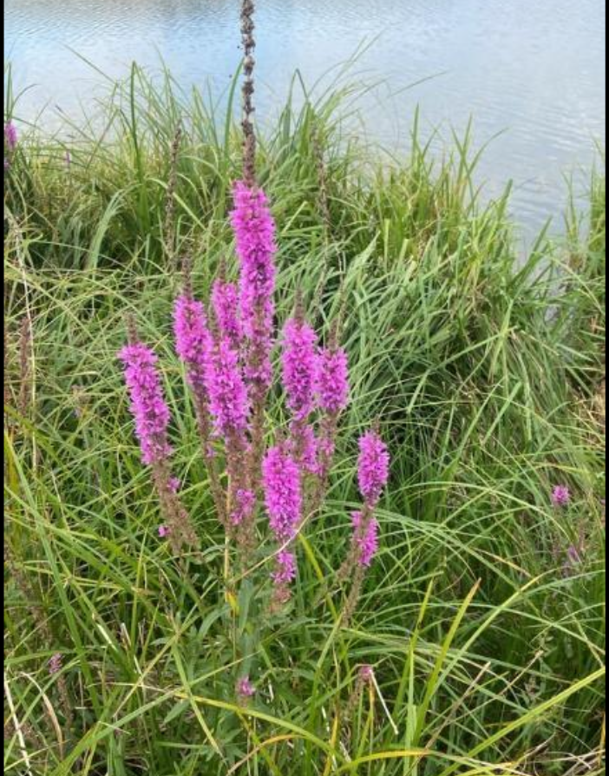
2025 Vegetation Surveys
Purple loosestrife (Lythrum salicaria) was the most common non-native plant.
At all sites it considered low-level, long-established, and unlikely to cause significant ecological impact.
It was found at low levels on six lakes:
  Redstone Lake — 3 points
  Little Redstone Lake — 3 points
  Burdock Lake — 3 points
  Tedious Lake — 2 points
  Bitter Lake — 1 point
  Coleman Lake — 1 point
Photo sourced from iNaturalist by blondie1
Notes:
Purple loosestrife is a tall, herbaceous perennial wetland plant with a square, woody stem and spikes of bright purple flowers that have five to seven petals. Its leaves
are smooth-edged, lance-shaped, and grow opposite each other or in whorls. The plant can grow up to 2.4 meters high and has is considered invasive in Ontario.
Dense stands of purple loosestrife outcompete native plants for habitat. This results in changes to ecosystem function such as reductions in nesting sites, shelter and food for birds, fish and wildlife, as well as an overall decline in biodiversity." (from the Ontario Invasive Plant Council). If you find it on your property, download the Council's Best Management Practice for how best to remove it.
Pulling
Minimizing disturbance to the area is vital, since any soil disturbance by pulling or digging brings thousands of seeds to the soil surface.
Any part of the root system left in the soil can start a new plant. the entire root system must be removed from the soil to prevent re-sprouting.
it is important to mention here that all parts of the plant should be placed in a sealed, dark-coloured plastic bag and left in direct sun to “cook” for at least one week before disposal.
DO NOT compost live or viable plant material. DO NOT discard in a natural area. Wherever permitted, plant material should be burned
Cutting
Mowing and cutting require all cut plant parts to be removed, as purple loosestrife can regenerate from stem fragments.
Cutting must be done before the flower stalks go to seed and repeated regularly until the plants energy stores are exhausted. Cutting of purple loosestrife within three weeks of flowering should destroy the seed crop and prevent additions to the seed bank

Slide 14
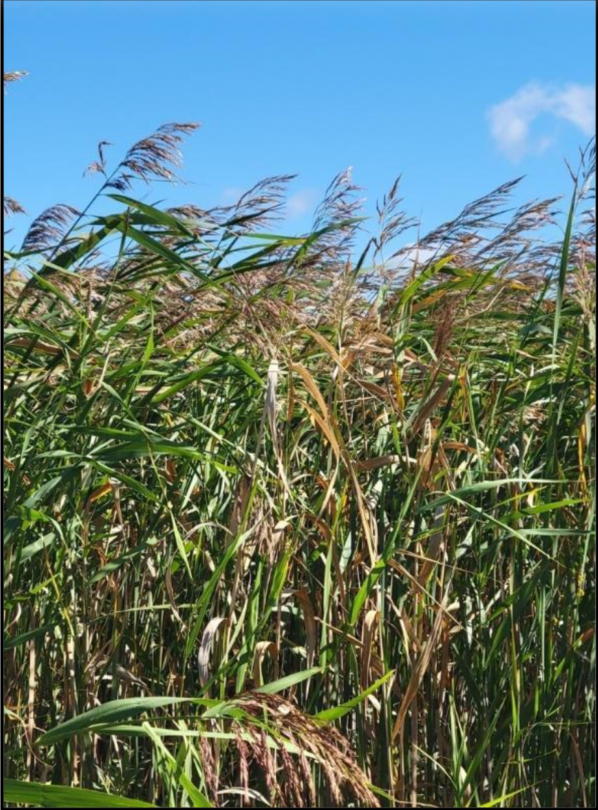
2025 Vegetation Surveys
Invasive Phragmites (Phragmites australis subsp. australis), a more concerning invasive species, was found at two points on Tedious Lake only. With sustained effort, removal may be feasible given the small number of occurrences.
Native Phragmites (subsp. americanus) was found on Burdock Lake but is not a concern.
Recommendation: multi-year removal program.
Photo sourced from iNaturalist by prairie anthropocene
Notes:
The introduced and invasive sub-species of Common Reed or Phragmites was found on Tedious Lake where Kennisis lake road comes to the lake at its southern eastern end.
Active management of this population is recommended.

Slide 15
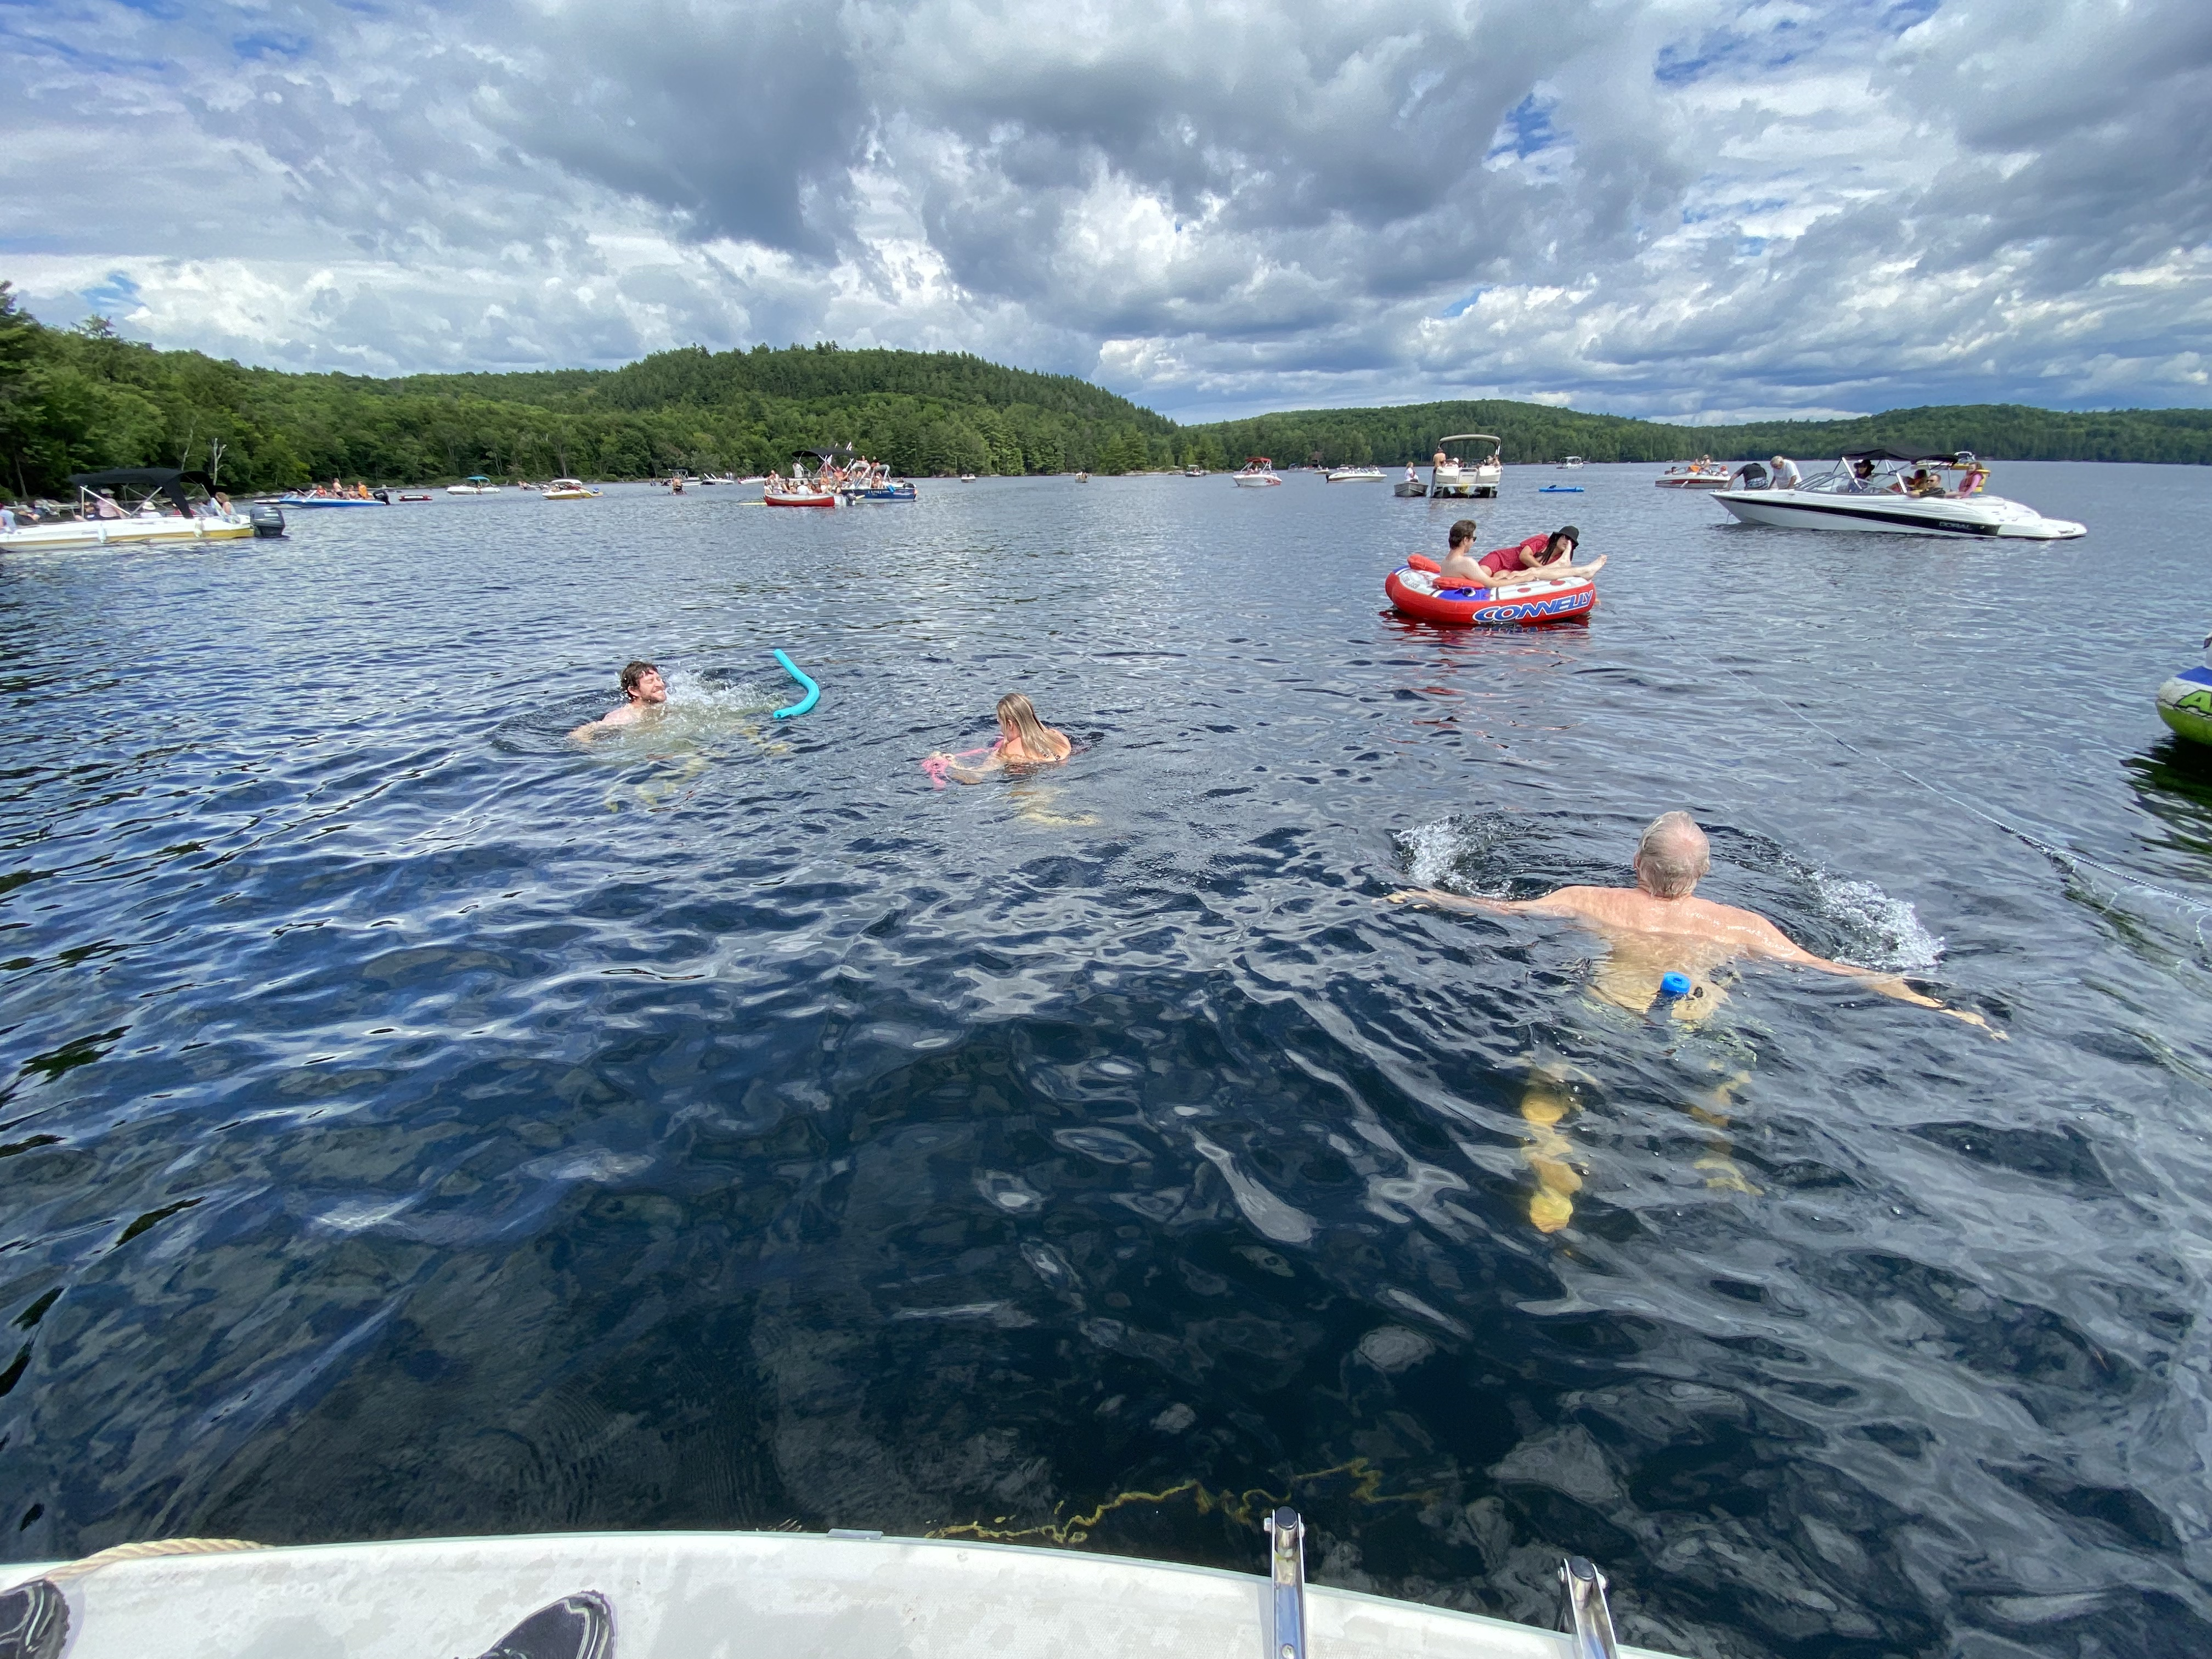
What can we do?
Awareness
  We can work together to reduce the impact of our collective actions.
  Do not assume the current health of our lakes will remain the same.
Protection
  Shoreline Restoration.
  Reduce boat speed within 30 m of shore.
  Maintain septic systems in good working condition.
  Clean, drain, dry your boats
  Don’t alter lake habitat
Monitoring
  Monitoring lake health will help us to identify the most urgent protective measures.
Notes:
11 suspected blooms in Haliburton county in 2020
What you can do
It’s up to all of us to work together to make sure our lakes stay healthy
Water quality of our lakes directly impacts our enjoyment of the lake and our property values
Try to leave twigs and bark of trees that you remove from your property (calcium)
Talk to Gerry about options to naturalize your shoreline
Make sure you and your guests use phosphorous free detergents and soaps, don’t use lawn fertilizers
Get your septic inspected and make sure it’s not being overloaded
Educate your friends and family about shoreline erosion caused by boat wakes
Monitoring provides information about lake health over time. This monitoring helps us to understand if our activities are negatively affecting lake health.
Opportunity with Halliburton Water Quality CBM that is currently under development.

Slide 16
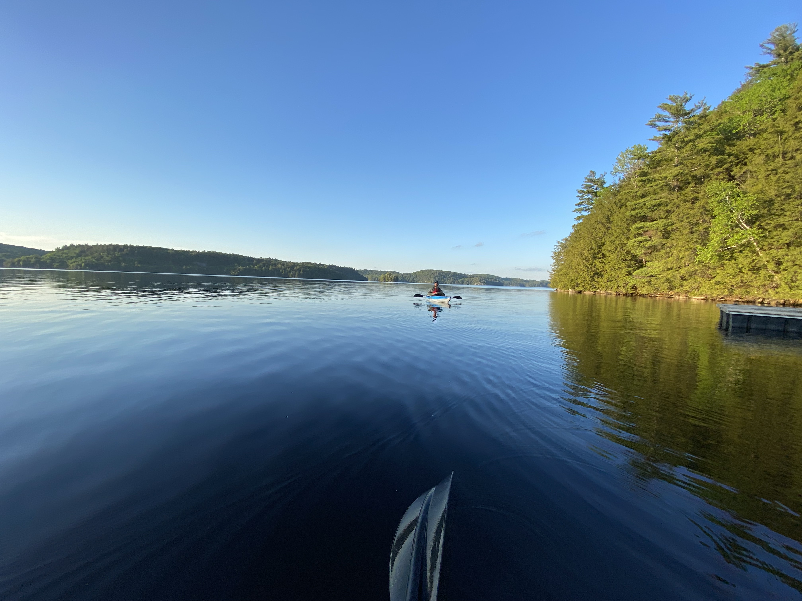
Monitoring Programs
RLCA lakes currently participate in the provincial Lake Partner Program
  Annual calcium + chloride + phosphorus samples
  Monthly secchi disk measurements
RLCA Lake Stewards will collect annual DO measurements in September
Options
  Van Dorn sampler to monitor deep water phosphorus
  Electrical conductivity logger to monitor chloride
  Invasive species management plan

Slide 17

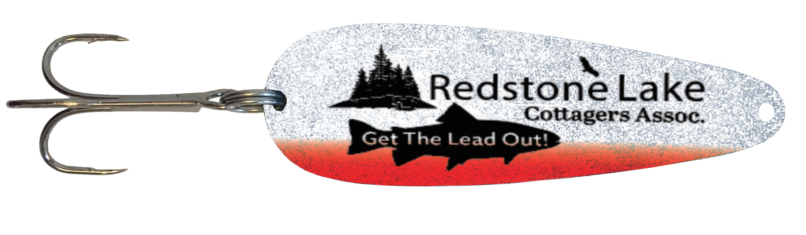
Get the Lead Out
Easily scratched or dented?
Weights, sinkers, jigheads
1 ounce or less
Any amount accepted
1 lure per cottage/member
Notes:
How do know if your tackle is lead? You can easily scratch it with your fingernail or dent it with a pair of pliers. Don’t want to empty your entire tackle box? Prioritize those sinkers, weights and jigheads that are under 1 ounce, painted or not.
Lead (Pb) is a neuro-toxin which attacks the nervous system and can lead to blindness, decreased reproductivity, seizures and death. Lead is fatal to loons and other aquatic birds.

Slide 18

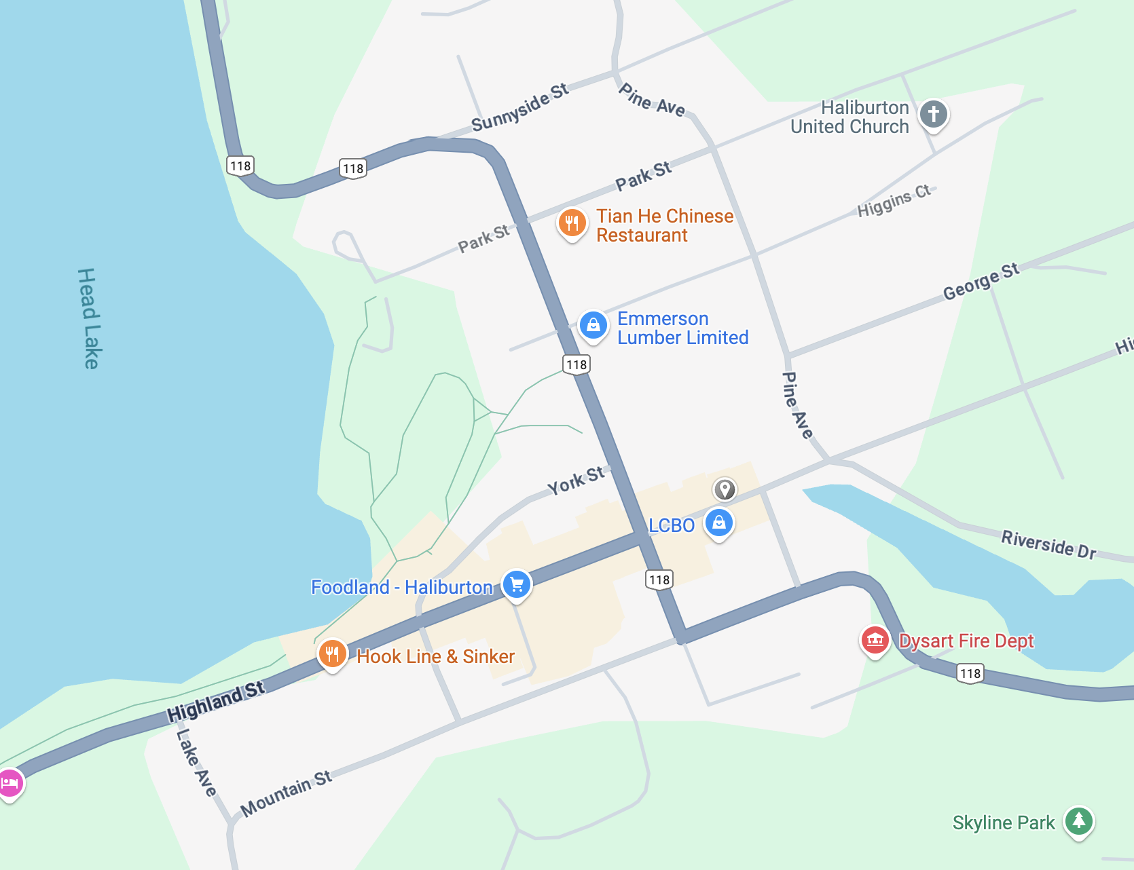
Injured turtle?
Pull over in a safe location
Collect the turtle
Call or text Turtle Guardians
Drop off the turtle in Haliburton
Keep an eye out in wet weather, and on the side of the roads during spring (nesting season).
If you cannot stop: call or text Turtle Guardians.
Phone 705-457-1222
SMS/Text 705-854-2888
235 Highland St. Lower Level.
(right next to Pet Value)

Slide 19
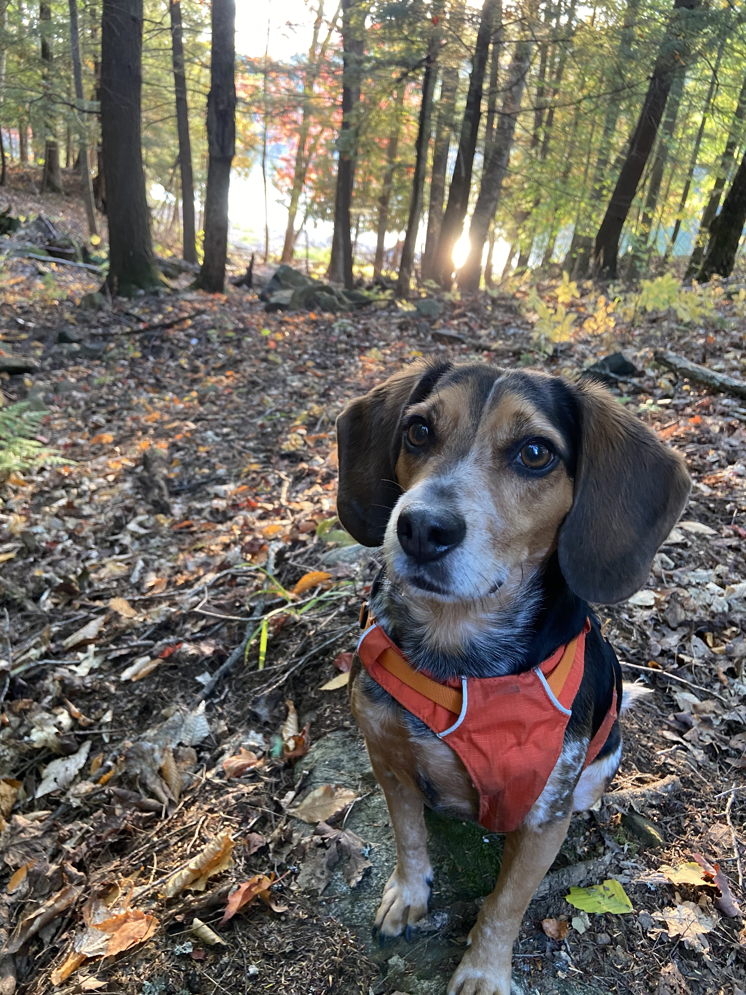
Questions?

Slide 20
References
Blakley, J., Bram, N., Vella, K., Marty, J., Nwanekezie, K., & Federoff, K. (2020). Lessons Learned, Best Practices and Critical Gaps in Regional Environmental Assessment: A Synthesis of Canadian and International Literature.
Cavanagh N, Nordin RN, Pommen LW, and Swain LG. 1998. Guidelines for Interpreting Water Quality Data: Field Test Edition (Version 1.0). Prepared by the Ministry of Environment, Lands and Parks Water Quality Branch for the Aquatic Ecosystems Task Force Resources Inventory Committee. Victoria British Columbia: The Province of British Columbia.
Eimers C. (2016). Cumulative Effects Assessment and Monitoring in the Muskoka Watershed. Waterloo, ON: Canadian Water Network. Available from: https://cwn-rce.ca/wp-content/uploads/2013/12/CWN-EN-Muskoka-2016-Web.pdf.
Gov BC [Government of British Columbia]. (2020a). Understanding Cumulative Effects in the Elk Valley. Victoria: Government of British Columbia. Accessed Nov 3, 2021. Available from: https://www2.gov.bc.ca/gov/content/environment/natural-resource-stewardship/cumulative-effects-framework/regional-assessments/kootenay-boundary/elk-valley-cemf.
Gov BC. (2020b). Enhancing Wildlife and Ecosystem Health with Road Rehabilitation. Victoria: Government of British Columbia. Accessed Nov 3, 2021.Available from: https://www2.gov.bc.ca/assets/gov/environment/natural-resource-stewardship/cumulative-effects/cemf_elkvalleyinfographics_roadrestoration_v03_01.pdf.
Gov BC.. (2021). Elk Valley Cumulative Effects Management Framework. Victoria: Government of British Columbia. Accessed Nov 3, 2021. Available from: https://www2.gov.bc.ca/gov/content/environment/natural-resource-stewardship/cumulative-effects-framework/regional-assessments/kootenay-boundary/elk-valley-cemf.
IAA [Impact Assessment Agency]. (2021). Regional Assessment Under the Impact Assessment Act. Ottawa: Government of Canada. Last modified March 11, 2021. Available from: https://www.canada.ca/en/impact-assessment-agency/services/policy-guidance/regional-assessment-impact-assessment-act.html.
Noble, B. (2021). Introduction to Environmental Assessment: A Guide to Principles and Practices (4th ed.). Don Mills: Oxford University Press.

Slide 21
Algal Blooms
Road Salt
Climate Change
Low Calcium
Low Dissolved Oxygen
Invasive Zooplankton
Faulty Septic Systems
Landscaping
Notes:
From Dr. Norman Yan’s presentation

Slide 22
